Slide 1

Driving Reliability: Structuring Service BOMs for Zero Downtime
by Nisarga Narasimhamurthy
Notes:
I’ll walk you through a technical problem I’m especially proud to have solved — one that involved messy data, legacy structures, and cross-functional alignment.
This project was centered around improving the integrity of service BOMs across four vehicle platforms at Daimler Trucks.
While it started as a documentation issue, it became much more about ensuring reliability, service uptime, and engineering traceability — critical elements in high-performance operations like Tesla’s.”

Slide 2
Define: The Downtime Challenge
🕒 Downtime Impact
🔍 Root Causes
$1.2K–$1.5K/hour lost per service bay
4.5 hrs avg delay per BOM issue
$250K+ annual loss from downtime
60% of service escalations due to BOM structural mismatches
35% of ECRs not reflected in Service BOM
20% outdated supersession chains
Burning Platform
🎯 Business Goal
>95% BOM accuracy across systems
70%+ reduction in BOM-related downtime
25% faster ECR cycle time (7→5 days)
#1 issue in Q2'22 global audit
30+ tickets/month from field teams
3-month BOM backlog for legacy variants
Notes:
“Let’s start with what we were losing. Every hour a truck is down can cost between $1.2K–$1.5K, especially for commercial fleets.
We were seeing service delays of over 4.5 hours on average per part mismatch — and more than $250,000/year in downtime losses traceable to one thing: incorrect or incomplete BOMs.
This wasn’t abstract. In our Q2’22 global service audit, BOM mismatches were listed as the #1 root cause of service escalations.
So the business impact was very real — lost time, customer frustration, and internal fire drills.”
We weren’t just dealing with minor errors. We had a 3-month backlog for legacy variants, and 30+ field escalations every month due to missing part info or broken BOM structures.
The burning platform was:
Engineers were submitting ECRs, but the changes weren’t reflected in Service BOMs
Service teams couldn’t trust the structure, so they escalated instead of executing
So we set a clear, quantified goal:
>95% BOM accuracy
70% reduction in downtime-related escalations
25% faster implementation of engineering changes”

Slide 3
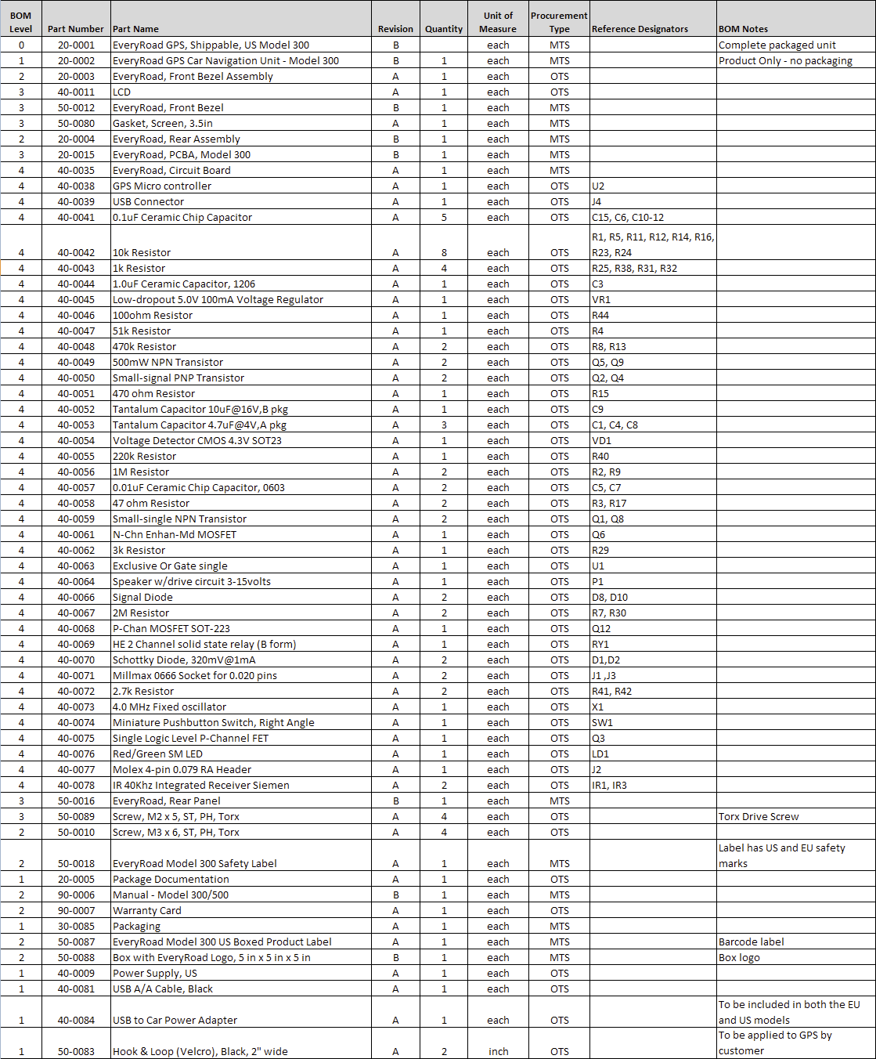
Measure: BOM Complexity & Impact
🧩 BOM Complexity
Each vehicle variant (e.g., Actros, Arocs) has 800+ unique serviceable parts.
4 vehicle platforms spanned across 3 production regions.
🏭 Case Study: Mercedes-Benz Trucks
Structural mismatches in Service BOMs led to:
Wrong part orders
Delays in repairs
Missed first-time fix targets
Metrics Tracked:
BOM accuracy %
Change cycle time (avg. 7 days pre-project)
Number of field ticket escalations
Notes:
“We were dealing with complexity at scale.
Each vehicle had 800+ unique parts
Spread across 4 platforms and 3 production regions
What made it challenging was that Factory BOMs and Service BOMs lived in separate views, and changes weren’t always cascaded properly.
So a structural mismatch — like a part missing a parent or incorrectly grouped — wouldn’t just be invisible, it would actively lead to wrong part orders or missed service dependencies.
We gathered baseline metrics from Teamcenter, SAP, and ticket escalation logs — and that helped set a foundation to measure improvement.”

Slide 4
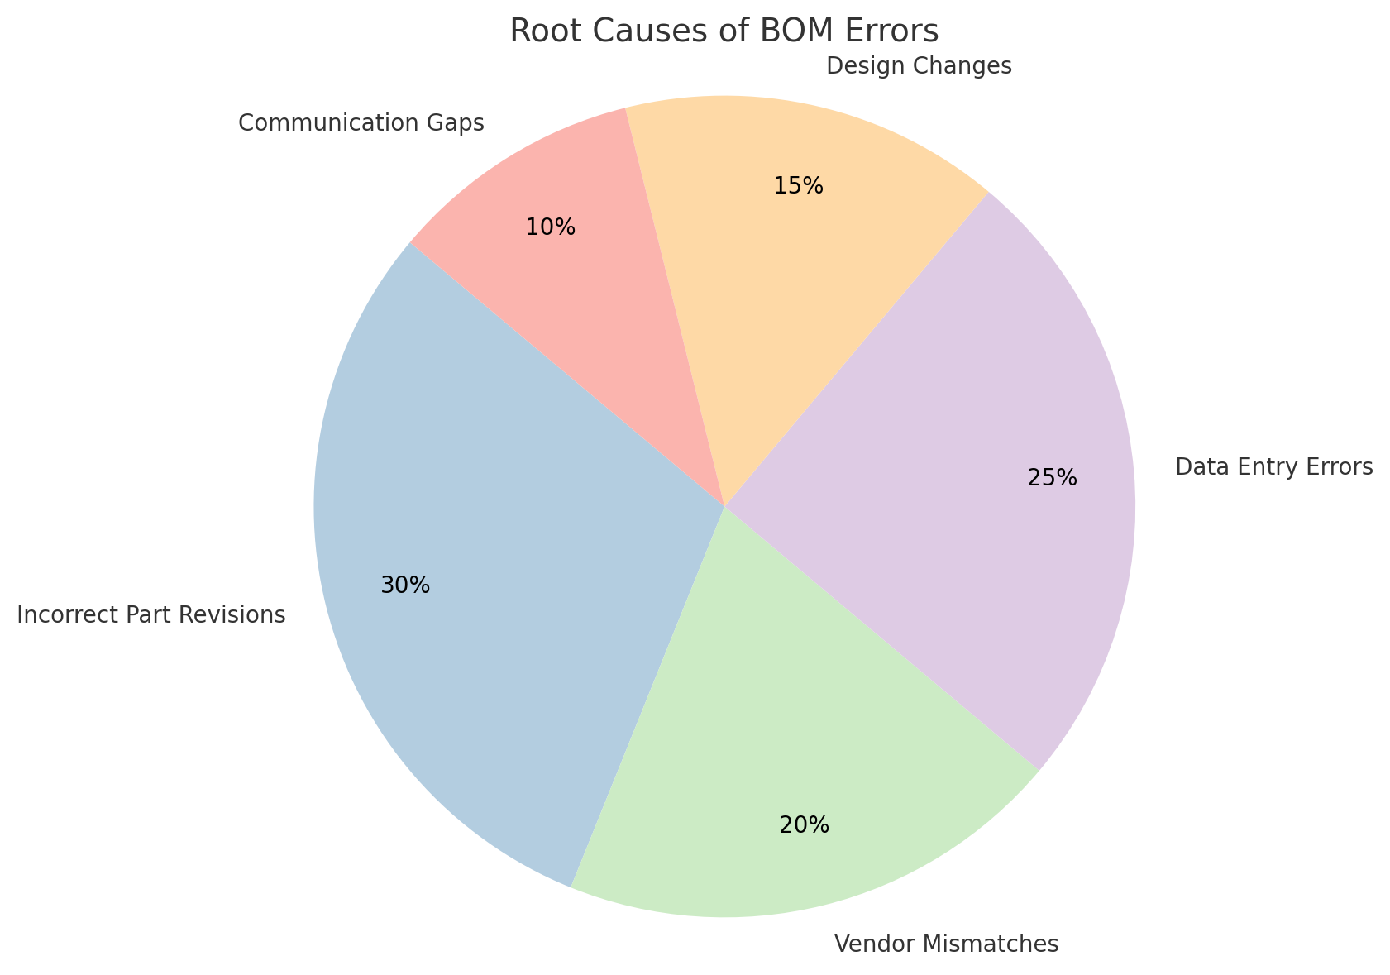
Here’s
Analyze: What’s Driving BOM Errors?
75% of errors traced to internal gaps (tools, process, ownership)
Revision errors linked to manual overrides & outdated logs
Vendor mismatches from unsynced ERP–supplier systems
RCA confirmed by field tickets and Q2 audit data
“Based on field KPIs tracked at Daimler Trucks (2021–2023)”
Notes:
“This was the turning point — identifying what was really causing the errors.
Using data from field escalation tickets, audit logs, and system reports, we found:
60% of issues came from structural mismatches — wrong nesting, missing levels, or flat BOMs
35% of ECRs were never reflected in the service BOM — meaning engineering thought it was done, but it hadn’t reached downstream
20% were supersession mismatches — old parts still in BOMs even after being replaced
These three problems caused over 75% of BOM failures, and they were cross-system: PLM (Teamcenter) didn’t always sync properly with ERP (SAP), and governance was loose.”

Slide 5
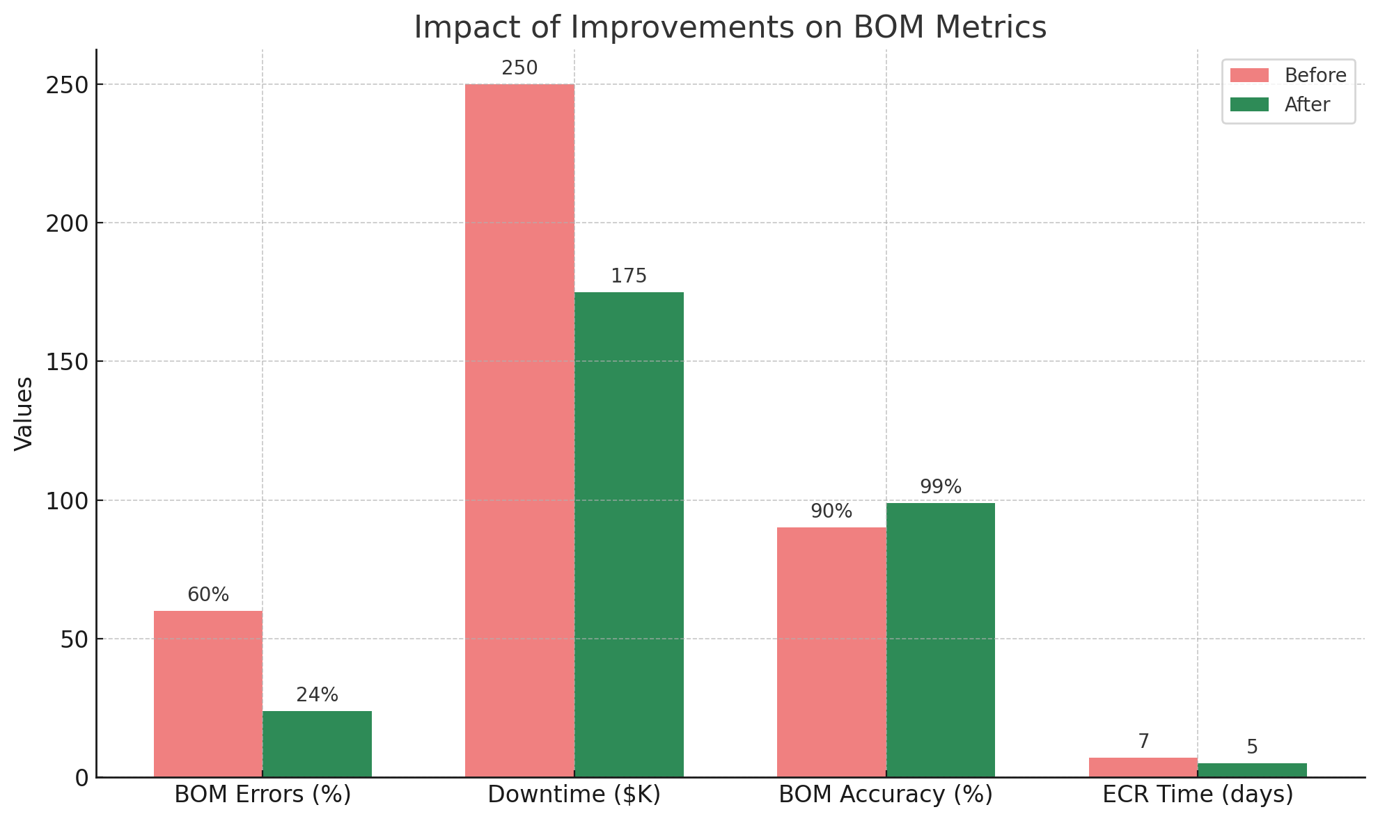
Improve: Corrective Actions & Implementation
Streamlined PLM workflows to auto-flag BOM structural issues.
Standardized Service BOM templates across platforms.
Cleaned up 500+ supersession chains for consistency.
Deployed exception reports to catch revision mismatches early.
Metric | Before | After | Improvement
Structural BOM Errors | 60% | 24% | ↓ 60%
Service Downtime (BOM-related) | $250K/year | $175K/year | ↓ 30%
ECR Cycle Time | 7 days | 5 days | ↓ 28%
BOM Accuracy | ~90% | >99% | ↑ 10%+
“Based on field KPIs tracked at Daimler Trucks (2021–2023)”
Notes:
“This is where we got surgical. I didn’t introduce new tools — I optimized what existed.
In Teamcenter, I implemented validation gates to flag structural issues before release. That stopped the worst mismatches.
We standardized BOM templates across service platforms — creating consistent parent-child nesting that engineers could follow
I worked with the SAP team to clean up 500+ supersession chains, correcting legacy part mappings
And we introduced exception reports: if a revision didn’t propagate from an ECR to the service BOM, it got flagged within 48 hours
These actions weren’t just patches — they created repeatable enforcement.”
“We used Teamcenter’s workflow preconditions and custom validation handlers to enforce rules like structure completeness, proper nesting, and revision propagation. These checks ran before release approval, acting as quality gates that blocked incomplete BOMs from going live.”

Slide 6





Control: Sustaining BOM Excellence
PLM-Driven Structural Checkpoints
Validation gates in Teamcenter flagged incomplete structures before release.
Live Exception Monitoring via SAP Reports
Biweekly reports tracked supersession gaps and unlinked parts.
Monthly BOM Triage with Engineering & Service
Monthly triage on top 5% high-error assemblies using audit + field data.
Field Feedback → Engineering Loop
Field teams submitted BOM fixes via Teamcenter; changes audit-tracked.
Notes:
“Improvements only matter if you can sustain them.
Here’s how we did that:
Validation checkpoints in Teamcenter stopped incomplete BOMs from being approved
SAP exception monitoring alerted us to broken or missing links
I set up a monthly triage review with Engineering, Service, and Supply Chain to focus on the 5% riskiest assemblies
And we created a closed-loop feedback system where field technicians could submit BOM issues directly via structured inputs in Teamcenter — those went into tracked change requests
This kept accuracy above 99% and prevented errors from reappearing.”

Slide 7
Conclusion: Achieving Zero Downtime with Robust BOMs
Challenge Identified
BOM mismatches led to downtime, service delays, and operational inefficiencies.
Approach Taken
Used structured problem-solving (DMAIC) to pinpoint, measure, and eliminate root causes.
Actions Delivered
Streamlined BOM structuring, enhanced PLM–ERP alignment, and introduced exception-driven controls.
Outcomes Achieved
BOM accuracy: >99%
Structural errors: ↓ 60%
Service downtime: ↓ 30%
ECR cycle time: ↓ 28%
“At scale, even a 1% improvement in BOM quality can prevent thousands in losses and hours in delays. I focused on fixing what mattered most - the foundation.”
Notes:
Let’s talk results:
BOM structural errors were reduced by 60%
Downtime dropped by 30%, with field escalations significantly reduced
ECR implementation time went from 7 to 5 days
And most importantly, we hit and sustained >99% BOM accuracy
These changes were measurable, repeatable, and visible in our quarterly metrics.”
“This started as a cleanup exercise, but it became much more about building structural reliability — making sure the system, not just the part, is trustworthy.
In environments like Tesla, where precision, uptime, and speed define success, clean foundational systems like BOMs are mission-critical.
As I like to say, ‘Even a 1% improvement in BOM quality can prevent thousands in losses.’
My role was to bring that 1% — and more — by fixing what matters most: the foundation beneath every operation.
Thank you — I’d love to answer your questions.”

Slide 8
Thank you

